Slide 1
Examples using if-else

Slide 2
Outline
Example 1: Computing the square root
Example 2: Finding the number of real roots of a quadratic equation.
Example 3: Outputting three numbers in a non-descending order.

Slide 3
Example 1
Objective: To write a program to output the square root of a number.
This example illustrates also how to use a pre-defined function to compute the square root of a number.

Slide 4
Example 1: Solution
1
2
3
4
5
6
7
8
9
10
11
12
13
14
15
16
17
18
#include <stdio.h>
#include <math.h> // You need this line to use sqrt()
int main(void) {
double num, result;
scanf("%lf", &num);
if (num >= 0) {
result = sqrt(num);
printf("The square root of %.4f is %.4f.\n", num, result);
}
else
printf("Can't compute square root for negative number.\n");
return 0;
}
sqrt(num) computes the square root of num and yields the result as a value of type double.

Slide 5
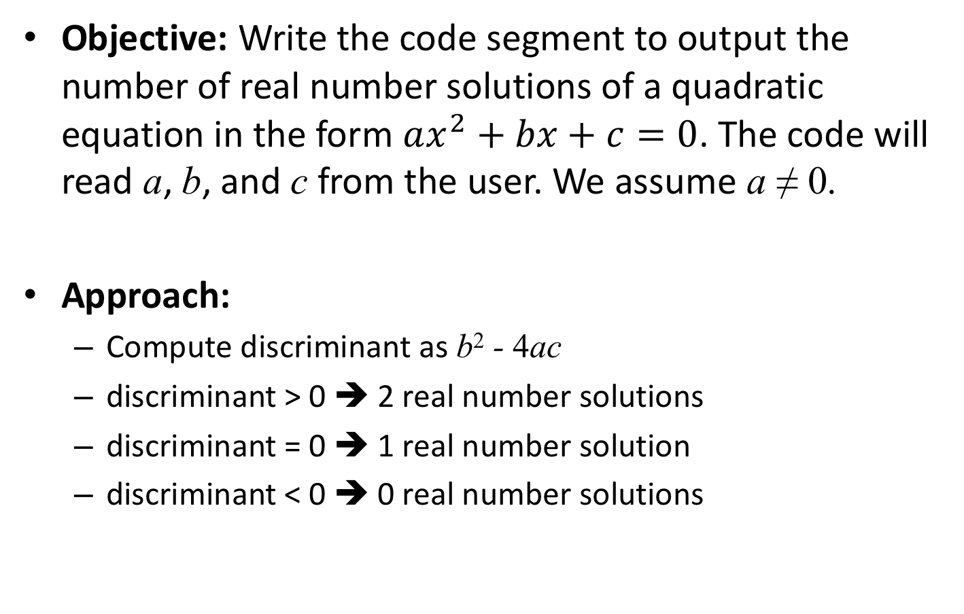
Example 2
Objective: Write the code segment to output the number of real number solutions of a quadratic equation in the form $ax^{2}+bx+c=0$. The code will read a, b, and c from the user. We assume a ≠ 0.
Approach:
Compute discriminant as b² - 4ac
discriminant > 0 ➔ 2 real number solutions
discriminant = 0 ➔ 1 real number solution
discriminant < 0 ➔ 0 real number solutions

Slide 6
Example 2: Solution #1
1
2
3
4
5
6
7
8
9
10
11
12
13
14
double a, b, c; // To store the coefficients
scanf("%lf%lf%lf", &a, &b, &c);
if (b * b – 4 * a * c > 0)
printf("# of real number solutions: 2\n");
if (b * b – 4 * a * c == 0)
printf("# of real number solutions: 1\n");
if (b * b – 4 * a * c < 0)
printf("# of real number solutions: 0\n");

Slide 7
Example 2: Solution #2
1
2
3
4
5
6
7
8
9
10
11
12
13
14
15
16
double a, b, c; // The coefficients
double dis; // The discriminant
int sol; // # of real number solutions
scanf("%lf%lf%lf", &a, &b, &c);
dis = b * b – 4 * a * c; // Compute discriminant only once
if (dis > 0)
sol = 2;
else if (dis == 0)
sol = 1;
else // Otherwise dis < 0
sol = 0;
printf("# of real number solutions: %d\n", sol);

Slide 8
Notes about Example 2
In solution #2, b*b-4*a*c is only evaluated once, and thus the amount of computation is reduced.
Solution #2 uses one printf() to output the result. The advantage is, if we need to change the output format, we only need to change one printf() statement.

Slide 9
Example 3
Objective: Write the code segment to read three integers from a user and output them in a non-descending order.
Assume the values are stored in variables x, y, and z
Approach #1:
For each of the six possible arrangements, output the result accordingly: (1) x ≤ y ≤ z, (2) x ≤ z ≤ y, (3) y ≤ x ≤ z , (4) y ≤ z ≤ x, (5) z ≤ x ≤ y, (6) z ≤ y ≤ x
Approach #2:
Sort the values of x, y, and z so that x ≤ y ≤ z.

Slide 10
Example 3: Solution #1a
1
2
3
4
5
6
7
8
9
10
11
12
13
14
15
16
int x, y, z; // To store input values
scanf("%d%d%d", &x, &y, &z);
if (x <= y && y <= z)
printf("%d %d %d\n", x, y, z);
else if (x <= z && z <= y)
printf("%d %d %d\n", x, z, y);
...
else if (z <= x && x <= y)
printf("%d %d %d\n", z, x, y);
else
printf("%d %d %d\n", z, y, x);

Slide 11
Example 3: Solution #1b (Broken implementation)
1
2
3
4
5
6
7
8
9
10
11
12
13
14
15
16
int x, y, z; // To store input values
scanf("%d%d%d", &x, &y, &z);
if (x <= y && y <= z)
printf("%d %d %d\n", x, y, z);
if (x <= z && z <= y)
printf("%d %d %d\n", x, z, y);
if (y <= x && x <= z)
printf("%d %d %d\n", y, x, z);
if (y <= z && z <= x)
printf("%d %d %d\n", y, z, x);
if (z <= x && x <= y)
printf("%d %d %d\n", z, x, y);
if (z <= y && y <= x)
printf("%d %d %d\n", z, y, x);
Without using else, this implementation would produce multiple output when two or more input variables share the same value.
e.g., when x, y, z are all 6, the output "6 6 6" would appear six times.

Slide 12
Example 3: Solution #2
1
2
3
4
5
6
7
8
9
10
11
12
13
14
15
16
17
int x, y, z, tmp;
scanf("%d%d%d", &x, &y, &z);
// First, make sure that x holds the smallest value
if (x > y) { // If y is smaller
tmp = x; x = y; y = tmp; // swap x and y
}
if (x > z) { // If z is even smaller
tmp = x; x = z; z = tmp; // swap x and z
}
// Next, make sure y <= z
if (y > z) { // If z is smaller
tmp = y; y = z; z = tmp; // swap y and z
}
printf("%d %d %d\n", x, y, z);

